Slide 1
IDENTIFY BASIC LEADERSHIP SKILLS
DHS 413
Dr. E. E. Okoh

Slide 2
Introduction
Leadership in project environments requires the ability to influence, motivate, communicate effectively, and resolve conflict.
PMBOK emphasizes that project managers rely heavily on interpersonal and team skills, particularly motivation, active listening, and conflict management, to guide teams toward achieving project objectives.

Slide 3
THE ROLE OF MOTIVATION IN LEADING OTHERS

Slide 4
Definition of Motivation
PMBOK defines motivation as providing a reason for someone to act.

Slide 5
Why Motivation Matters in Leadership
Motivation is essential because:
Empowered teams perform better. PMBOK notes that teams are motivated when empowered to participate in decision making and encouraged to work independently.
Motivation increases commitment and productivity.
Motivated individuals take initiative, collaborate more readily, and navigate challenges effectively.

Slide 6
How Leaders Motivate (PMBOK Insights)
Empowerment: Allowing team members to contribute to decisions increases ownership and intrinsic motivation.
Recognition and Rewards: PMBOK states that rewards are powerful when tied to individual values and needs. Recognition throughout the project lifecycle helps people feel valued.
Opportunities for Growth: Teams are strongly motivated when they can grow, tackle challenges, and apply their skills.

Slide 7
How Leaders Motivate (PMBOK Insights)
Creating a Positive Work Environment: Motivation increases when team members feel trust, appreciation, and purposeful engagement.
Using Emotional Intelligence: Leaders who understand and manage emotions can motivate teams more effectively.

Slide 8
Key Takeaway
Motivation is not only about rewards—it's about creating a climate where people want to contribute, feel capable, and experience meaning in their work.

Slide 9
Discussion Prompts
“Think of a time you felt extremely motivated at work or school. What did the leader do?”
“Which motivates professional adults more: recognition, autonomy, or compensation? Why?”

Slide 10
Discussion Prompts
“PMBOK says empowerment increases motivation. What does empowerment look like in everyday leadership?”
“Can you motivate someone who is disengaged, or must motivation come from within?”

Slide 11
THE ROLE OF LISTENING IN LEADERSHIP

Slide 12
What PMBOK Says About Listening
PMBOK emphasizes active listening as a core interpersonal and communication skill used throughout project environments.
Active listening helps:
Reduce misunderstandings
Improve communication and knowledge sharing
Strengthen trust and team cohesion

Slide 13
Active Listening and Effective Leadership
Leaders who listen actively can:
Understand concerns and barriers.
This builds rapport and leads to better decision-making.
Encourage participation.
People are more likely to contribute when they feel heard.

Slide 14
Active Listening and Effective Leadership
Resolve conflict early.
Many conflicts escalate due to lack of proper listening.
Increase influence.
PMBOK identifies “high levels of active and effective listening skills” as a key component of influence.

Slide 15
Active Listening Behaviours
Giving full attention
Acknowledging messages received
Asking clarifying questions
Reflecting and paraphrasing
Observing nonverbal cues
PMBOK notes that listening is essential for leaders to inspire, provide vision, and support project knowledge sharing

Slide 16
Active Listening Behaviours
Giving full attention
Acknowledging messages received
Asking clarifying questions
Reflecting and paraphrasing
Observing nonverbal cues
PMBOK notes that listening is essential for leaders to inspire, provide vision, and support project knowledge sharing

Slide 17
Discussion Prompts
“Why is active listening difficult for leaders? What gets in the way?”
“PMBOK identifies active listening as a major influencing skill. How does listening increase influence?”

Slide 18
Discussion Prompts
“Think of a leader who listened well. What made their behaviour effective?”
“Is listening more important than speaking for leaders? Why or why not?”

Slide 19
BASIC CONFLICT-MANAGEMENT STRATEGIES

Slide 20
Conflict Management
PMBOK states that conflict is inevitable on projects due to differing priorities, scarce resources, and personal working styles.
Successful conflict management leads to improved productivity, better decision-making, and stronger relationships.
Conflict should be addressed early and usually in private, using a direct and collaborative approach.

Slide 21
Five PMBOK Conflict-Resolution Techniques

Slide 22
i. Withdraw/Avoid
  Definition: Retreating from the conflict, postponing the issue, or allowing it to be resolved by others.
  Use When:
    The issue is minor
    Emotions are high and time is needed to cool down
    More information is required

Slide 23
ii. Smooth/Accommodate
  Definition: Emphasizing points of agreement rather than differences; giving in to maintain harmony.
  Use When:
    Preserving the relationship is more important than winning
    The leader is wrong or the issue is more important to the other party

Slide 24
iv. Force/Direct
  Definition: Pushing one’s viewpoint at the expense of others, often using authority; a win-lose approach.
  Use When:
    Quick decision-making is needed (e.g., emergencies)
    Safety or critical standards are at stake

Slide 25
v. Collaborate/Problem-Solve
  Definition: Incorporating multiple viewpoints to reach a consensus; a win-win solution.
  Use When:
    Long-term relationship matters
    Issue is complex and requires creative solutions
    All stakeholders must be committed to the outcome

Slide 26
Choosing the Right Strategy
Factors affecting the choice of conflict-resolution method include:
Importance of the issue
Time pressure
Power dynamics
Relationship importance
Long-term vs short-term objectives

Slide 27
Discussion Prompts
“Which conflict strategy do you tend to use personally? Is it effective?”
“PMBOK says collaboration leads to a win-win. Why don’t leaders use it more often?”
“When is compromise harmful? When is it helpful?”

Slide 28
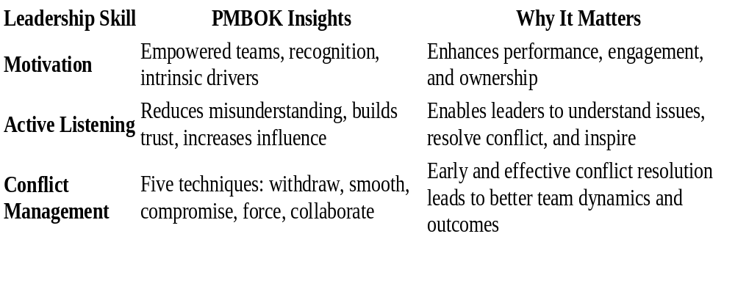
SUMMARY
.

